Slide 1
Meeting 1:
Enforcing Correct Hand Positioning during X-Rays

Slide 2
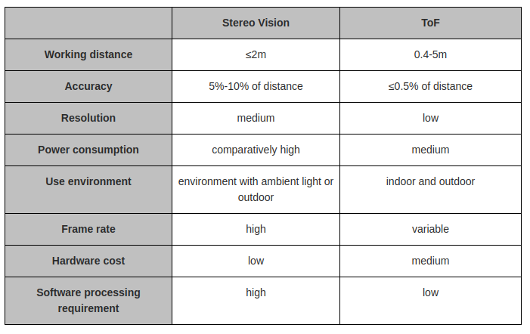
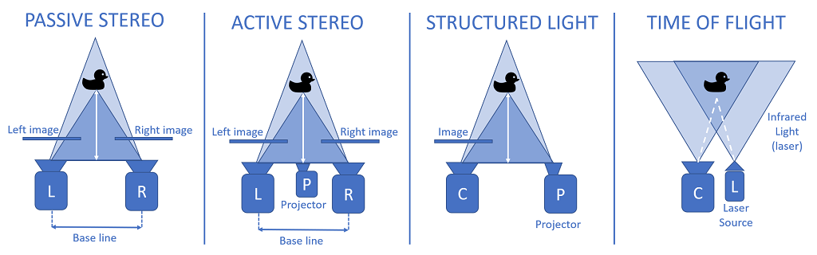
Sensor Information Correction
Camera has stereo-depth, not time of flight.
Might struggle if lighting isn't good.
Solution: Ring light included in tripod.
https://www.seeedstudio.com/blog/2020/07/03/3d-imaging-technology-comparison-tof-time-of-flight-vs-stereo-vision-m/

Slide 3
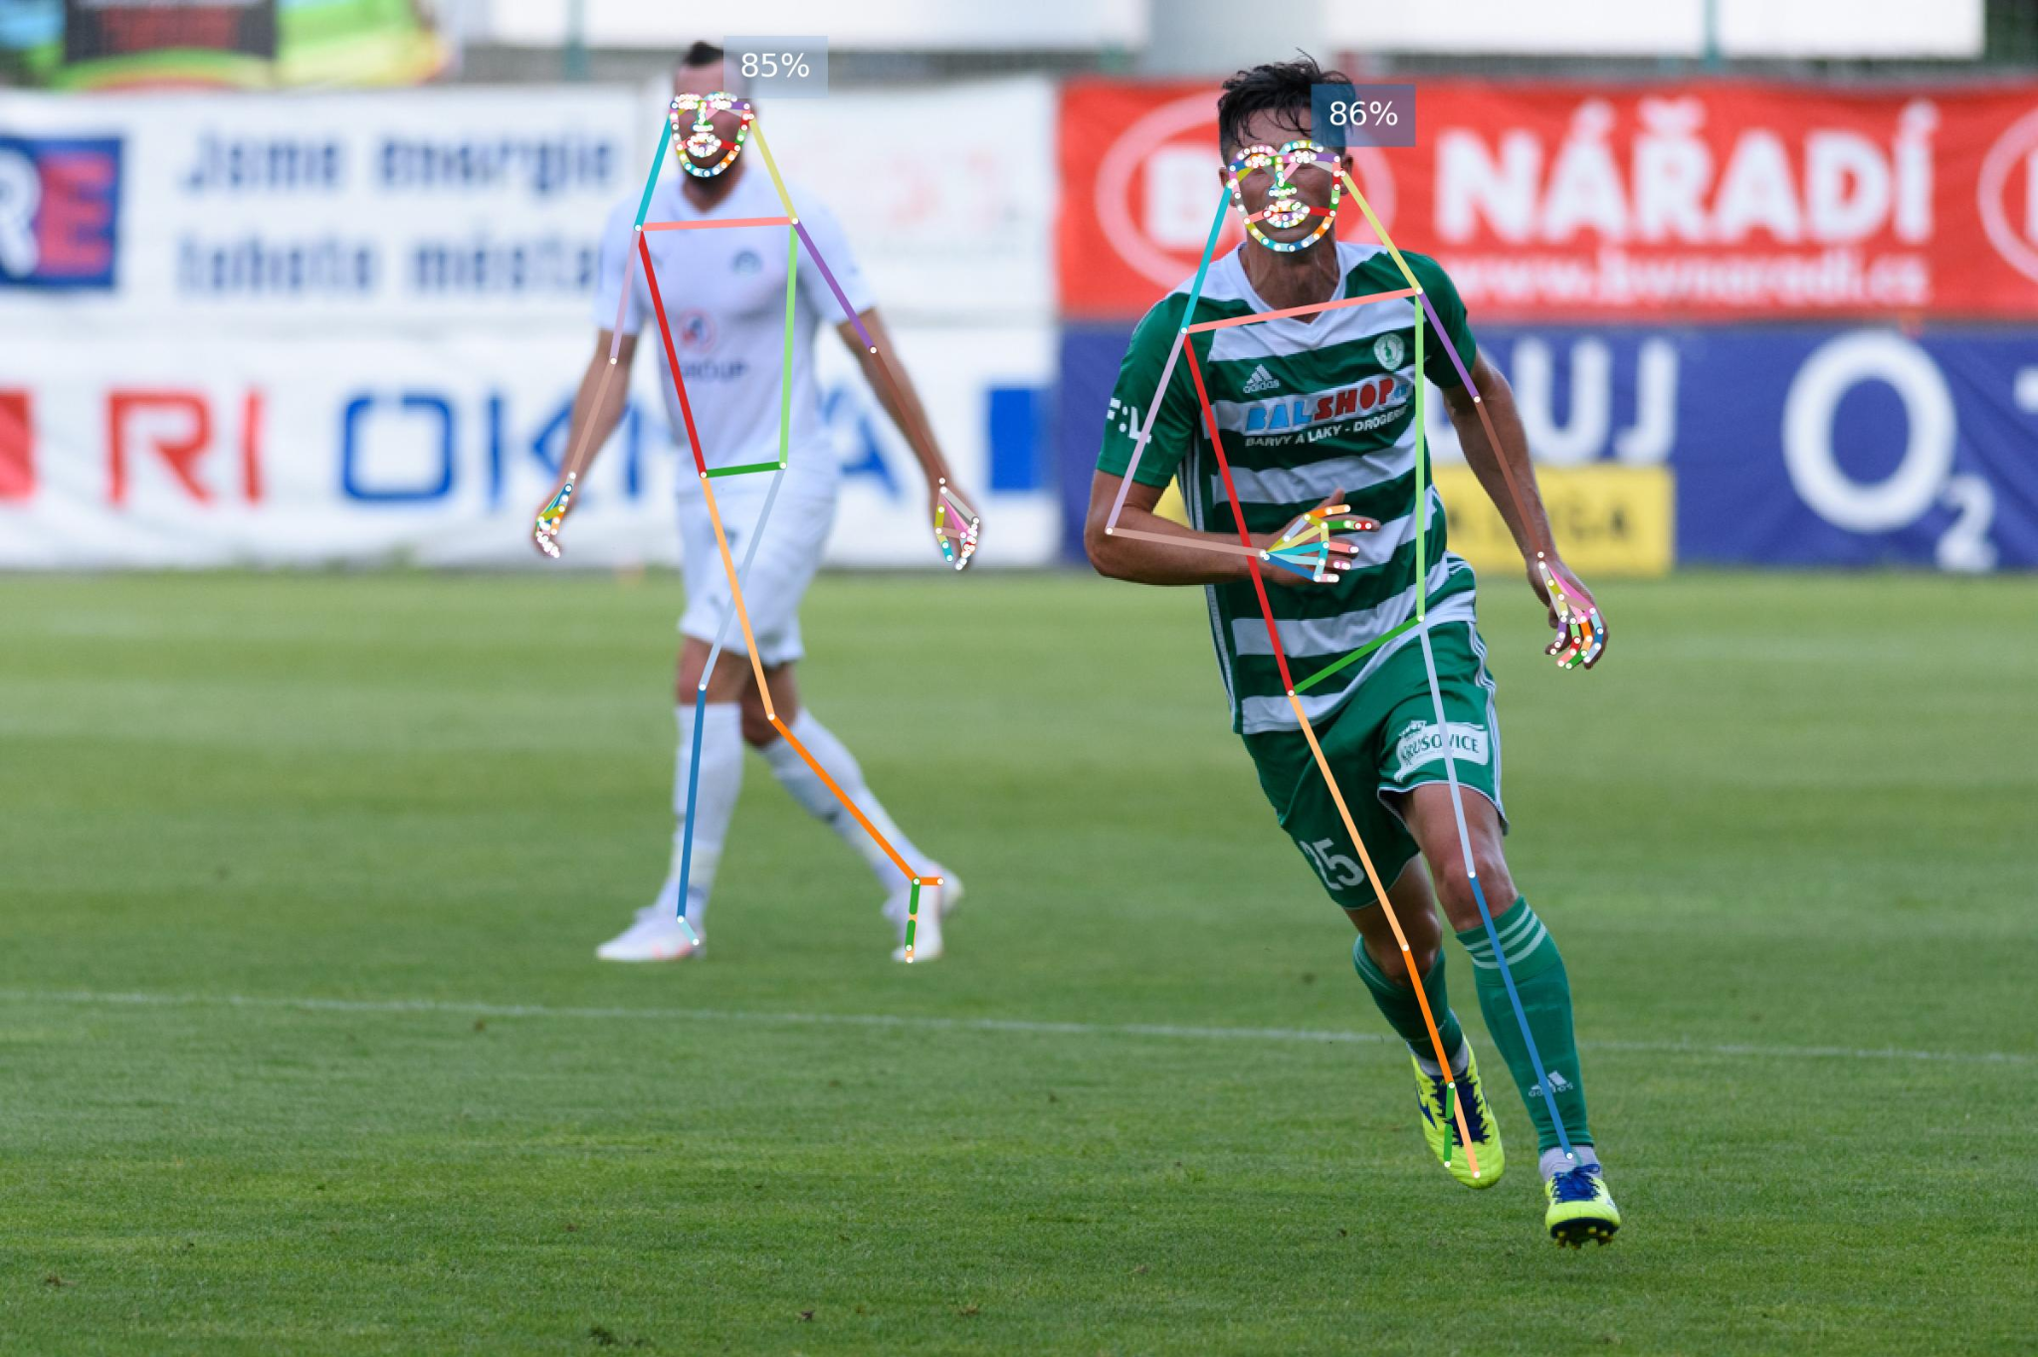
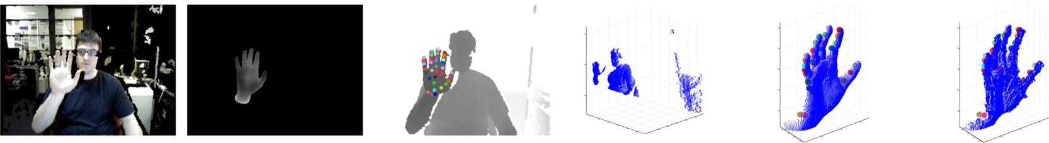
Literature Review
Hand Pose Estimation Datasets
NYU Hands (RGBD)
ICVL Hands (Depth only)
COCO Whole Body (RGB)
MSRA Hand Dataset (RGBD)
COCO Whole Body Dataset Example
NYU Hands Dataset Example
Notes:
NYU Hands:
[Kinect v1] Structured Light works by projecting a known pattern of light onto an object and then analyzing the distortion of the pattern in the reflected light to calculate a depth map of the object1. This method is used in the Kinect v1.
[Kinect v2] Time of Flight, on the other hand, works by illuminating a scene with modulated light and then measuring the time it takes for the light to travel from the camera to the scene and back to calculate a depth map2. This method is used in the Kinect v2.
ICVL Hands:
[Intel Creative Depth Sensor] Stereo Depth Sensor

Slide 4
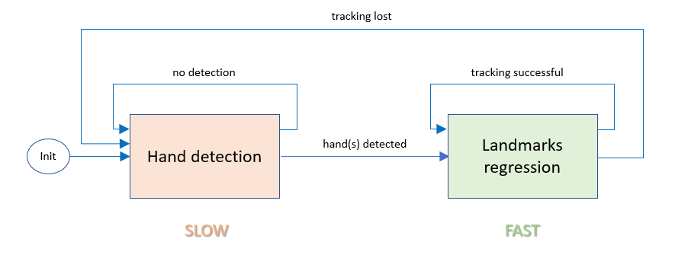
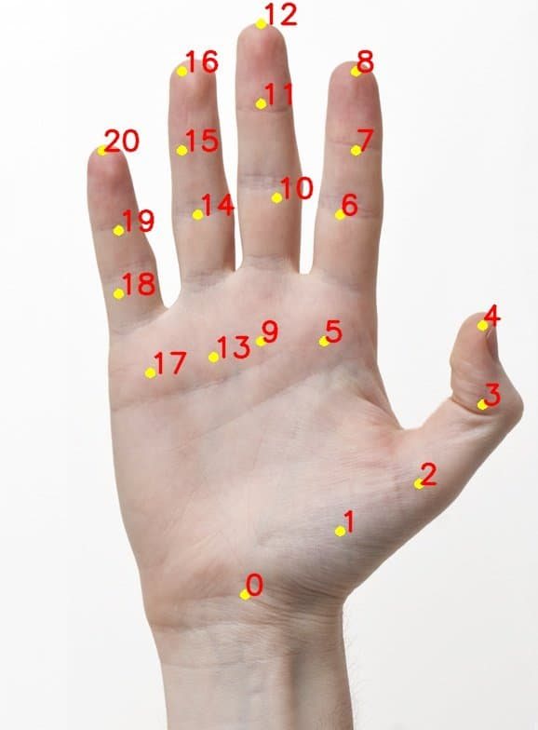
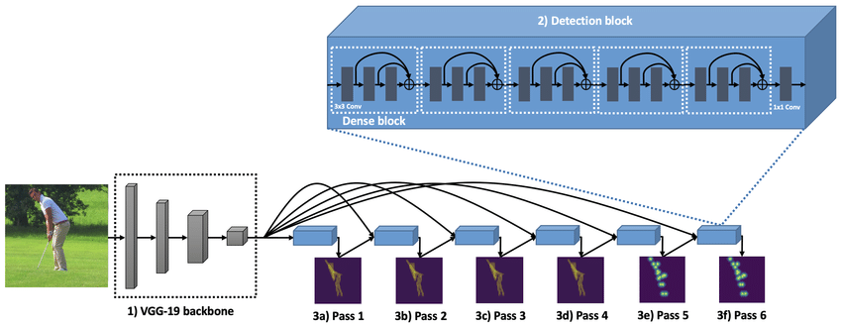
Literature Review
Hand Pose Estimation Models
Google MediaPipe Hand Estimation
CMU OpenPose
Notes:
https://www.google.com/url?sa=i&url=https%3A%2F%2Fwww.researchgate.net%2Ffigure%2FOpenPose-architecture-utilizing-1-VGG-19-feature-extractor-and-2-4-2-passes-of_fig1_340963703&psig=AOvVaw1a0rM1nkx00aNgYKg8snS7&ust=1679999816646000&source=images&cd=vfe&ved=0CBAQjRxqFwoTCOj0gpT1-_0CFQAAAAAdAAAAABAt
https://www.google.com/url?sa=i&url=https%3A%2F%2Flearnopencv.com%2Fhand-keypoint-detection-using-deep-learning-and-opencv%2F&psig=AOvVaw1PUaMaILVkHidE_EQyukcx&ust=1679999538837000&source=images&cd=vfe&ved=0CAwQjRxqFwoTCOjg9I_0-_0CFQAAAAAdAAAAABAD
https://github.com/geaxgx/depthai_hand_tracker

Slide 5
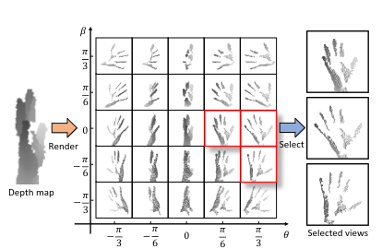
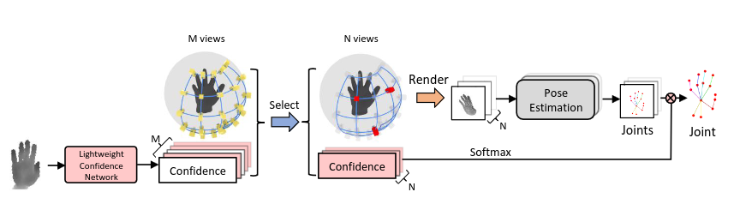
Literature Review
Efficient Virtual View Selection for 3D Hand Pose Estimation [SOTA on benchmarks]
https://arxiv.org/pdf/2203.15458v1.pdf

Slide 6
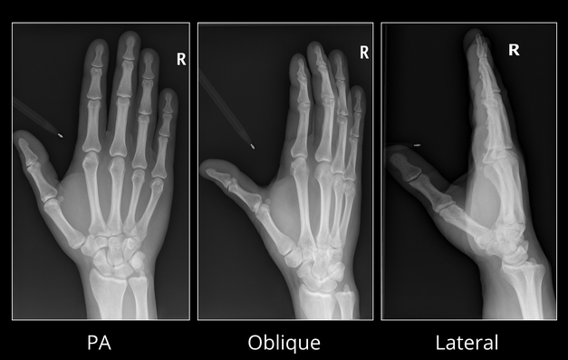
Literature Review
Most Common Hand Positions:
PA View
Oblique View
Lateral View
Other:
Lateral fan view
Lateral flexion view
Nørgaard projection
https://radiopaedia.org/articles/hand-series

Slide 7
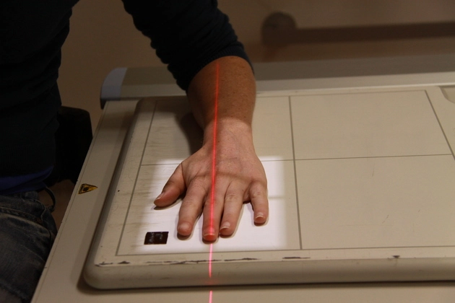
Literature Review
PA View:
patient is seated alongside the table
the affected arm if possible is flexed at 90° so the arm and hand can rest on the table
the affected hand is placed, palm down on the image receptor
shoulder, elbow, and wrist should all be in the transverse plane, perpendicular to the central beam
the hand and elbow should be at shoulder height which makes radius and ulna parallel (lowering the arm makes radius cross the ulna and thus relative shortening of radius)
Constraints:
All hand key-points must be in the same plane.
Elbow must be on the same plane as the tip of the middle finger and the wrist.
Hand plane must be parallel to table plane (table plane can be detected using depth sensor)
Maybe some space between fingers > 5 deg ?
Middle finger and elbow must be aligned with beam. Any ideas? If beam is always red, might be possible.
https://radiopaedia.org/articles/hand-series

Slide 8
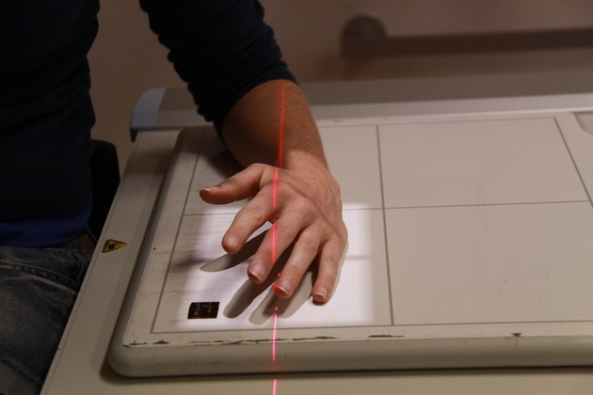
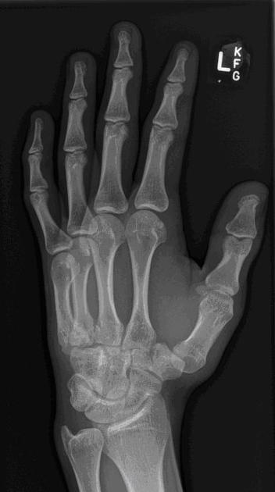
Literature Review
Oblique View
patient is seated alongside the table
the affected arm if possible is flexed at 90° so the arm and hand can rest on the table
the hand is rotated externally by 45 degrees from the basic PA position with fingers kept in extension and parallel to image receptor
shoulder, elbow, and wrist should all be in the transverse plane, perpendicular to the central beam
the hand and elbow should be at shoulder height which makes radius and ulna parallel (lowering the arm makes radius cross the ulna and thus relative shortening of radius)
Constraints:
All hand key-points must be in the same plane.
Elbow to wrist line must be parallel to table.
Hand plane must be oblique (40-50 deg) to table plane
Maybe some space between fingers > 5 deg ?
Elbow to wrist must be aligned with beam

Slide 9
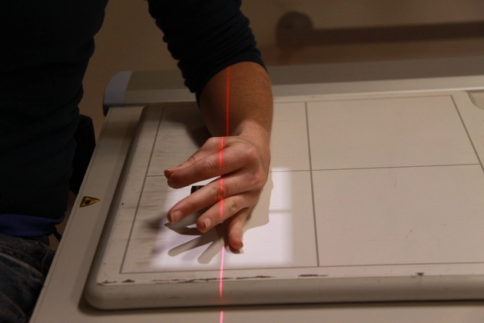
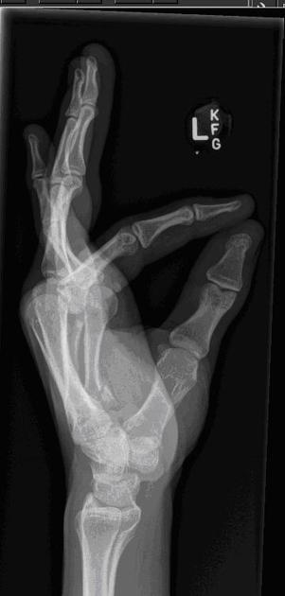
Literature Review
Lateral View
patient is seated alongside the table
hand is externally rotated by 90 degrees from the PA position so that the palm is perpendicular to the image receptor
fingers are kept extended with thumb abducted
fingers should ideally be separated to minimize superimposition and increase diagnostic information contained in the image
Constraints:
Little finger, wrist and elbow must be in the same plane (Plane A). Plane A must be perpendicular to the table plane.
In the sagittal plane*, fingers except thumb must be separated at PIP by 15-20 degs.
Tip of thumb and index must be < 1cm distance (ie touching)
Plane A must be aligned with beam.
*Sagittal plane where the coronal plane is a PA view of the hand.

Slide 10
Literature Review
Other attempts:
Automated Classification of Radiographic Positioning of Hand X-Rays Using a Deep Neural Network
Doesn't really address the issue: classifies the view of the hand X-Rays after capture
Hand and finger X-ray positioning device
Uses a physical device for hand positioning
Hand immobilizing and positioning apparatus for x-ray examinations
Same as previous
Saun, Tomas J. “Automated Classification of Radiographic Positioning of Hand X-Rays Using a Deep Neural Network.” Plastic surgery (Oakville, Ont.) vol. 29,2 (2021): 75-80. doi:10.1177/2292550321997012
Richard, G., Eaton., John, J., Keyser. (1984). Hand and finger X-ray positioning device.
Peter, E., Buckland. "Hand immobilizing and positioning apparatus for x-ray examinations." null (1994).

Slide 11
Additional Information
March 15: Concordia GCS Innovation Fund - 50k CAD -> FAIL

